Slide 1
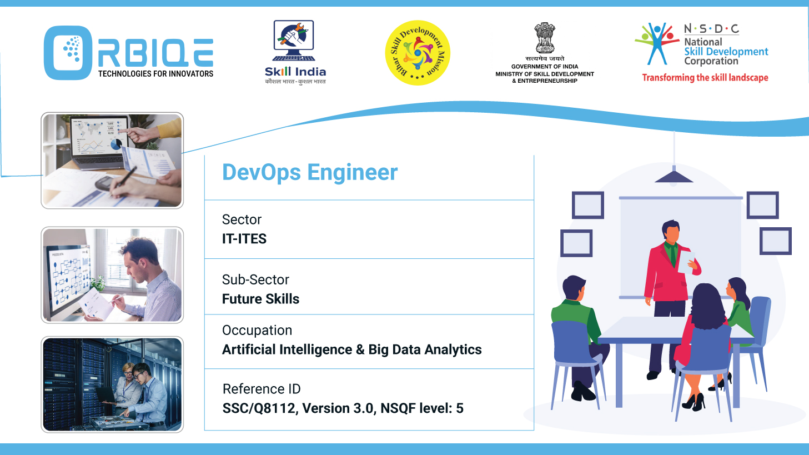
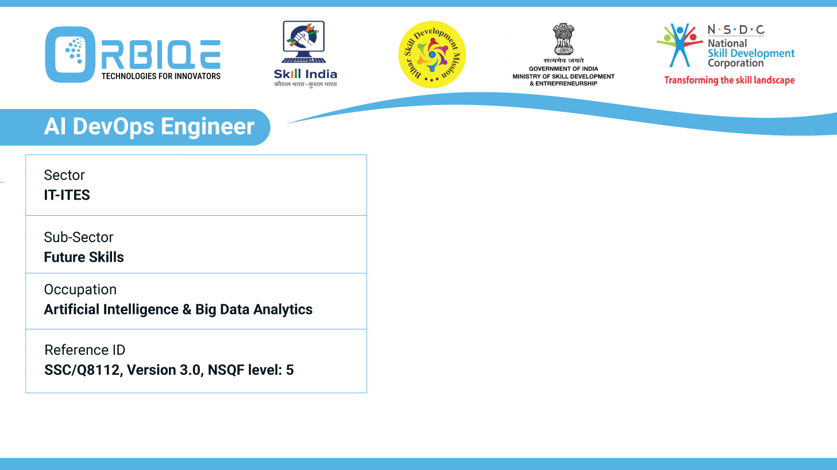
Name- Krishna Kant Dubey

Slide 2

Continuous Improvement and Feedback Loops

Slide 3
Agenda
Continuous improvement by soliciting feedback from stakeholders
Monitoring key performance indicators
Conduct regular retrospectives to reflect on successes, challenges, and areas for improvement

Slide 4
Continuous improvement by soliciting feedback from stakeholders

Slide 5
Monitoring key performance indicators

Slide 6
Conduct regular retrospectives to reflect on successes, challenges, and areas for improvement

Slide 7
Thank You

